Slide 1
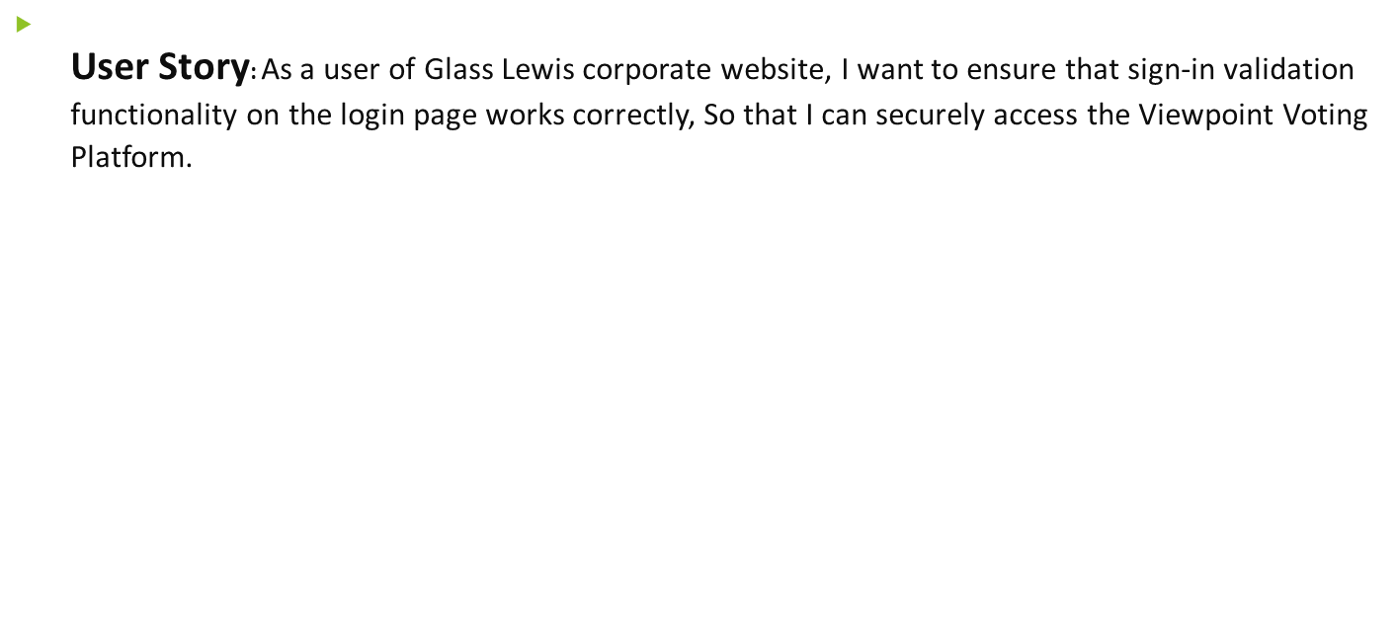
Software QA Engineer - Test Challenge 2024
Question 1 - Requirements

Slide 2

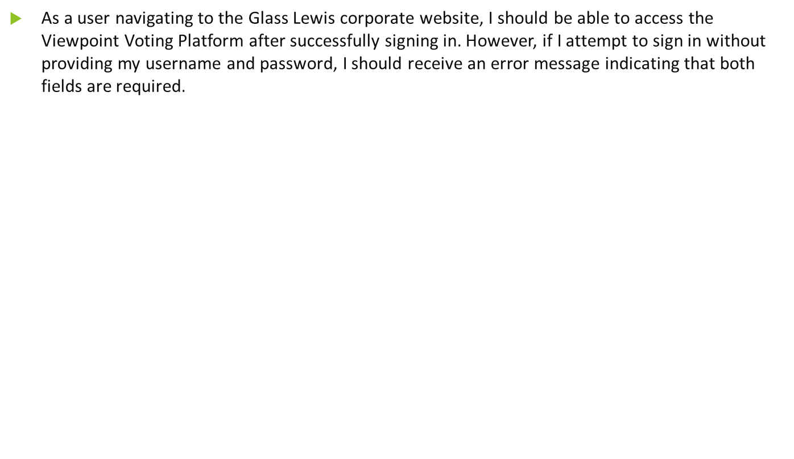

Slide 3

